Slide 1
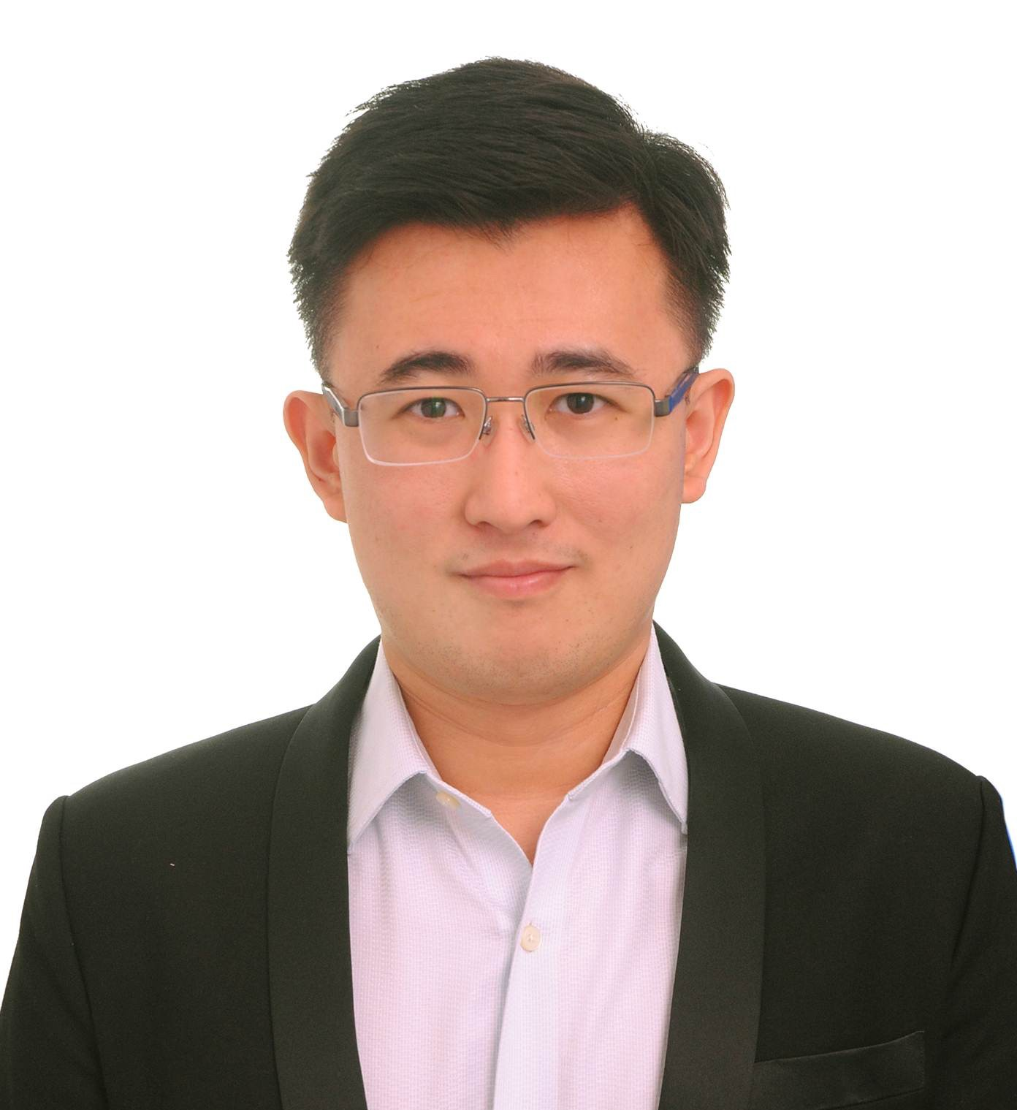
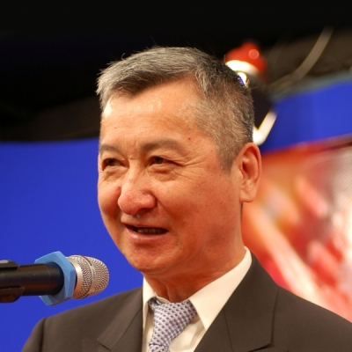
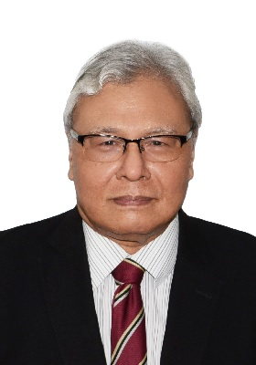
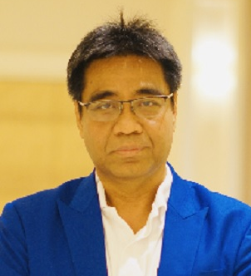
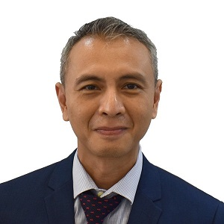
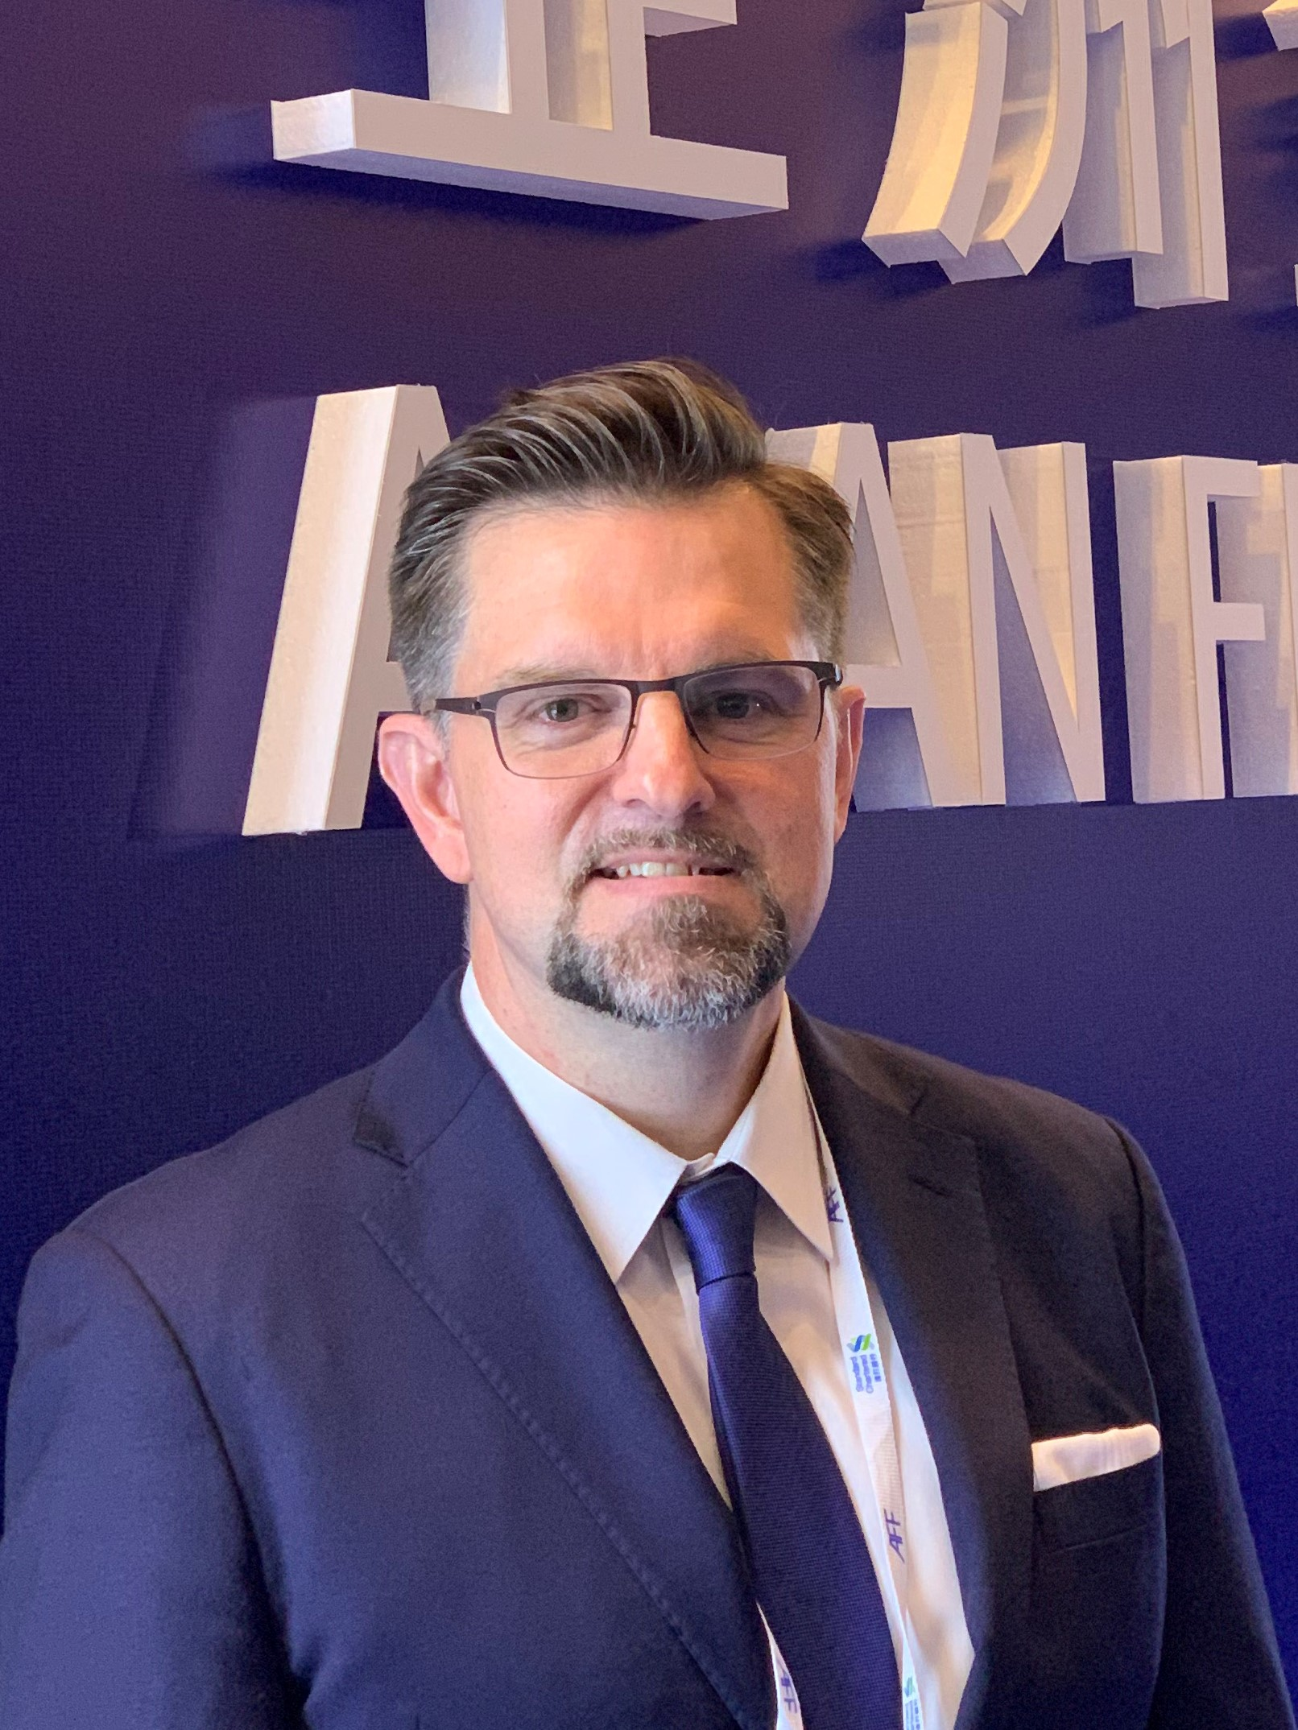
Are ASEAN states ready to implement online teaching and learning across all levels of education?
Sum Li Kang Executive Director Pelangi Publishing Group (KLSE:PPG)
Mr. WANG Cheung Yue, Fred Chairman Salon Films Group & Hon VP of the China Film Foundation, Director of the Board of the HK International Film Festival Society
Dato Kamil Othman Director of Limkokwing Film Academy & Founder Digital Content Education Council
Dr Wagheeh Shukry bin Hassan Deputy Director Educational Technology & Resources Division (BSTP)Malaysian Ministry of Education
Dr. Supot Rattanapun Managing Director Top Publishing Co. & Executive Committee
The Publishers and Book Sellers Association of Thailand (PUBAT)
Moderator:
Michael Walsh PBEC CEO

Slide 2
Topic: The Digitalisation of Education – An ASEAN perspective
Are ASEAN states ready to implement online teaching and learning across all levels of education? Only 19.7% of a recent survey agreed that Malaysia for instance is ready for online teaching and learning for kindergartens, 25% for primary and secondary schools, and 30% for higher learning institutions. These findings and in other ASEAN countries like Thailand highlight the need for the digitalisation of government services to be given more attention, especially considering the ongoing pandemic and potential future crises. So what is happening, what can be done to speed up the process and how can other tools like film and upskilling be a part of the solution?

Slide 3
DIGITAL
LEARNING
Partnerships in Learning
#MyAPEC2020

Slide 4
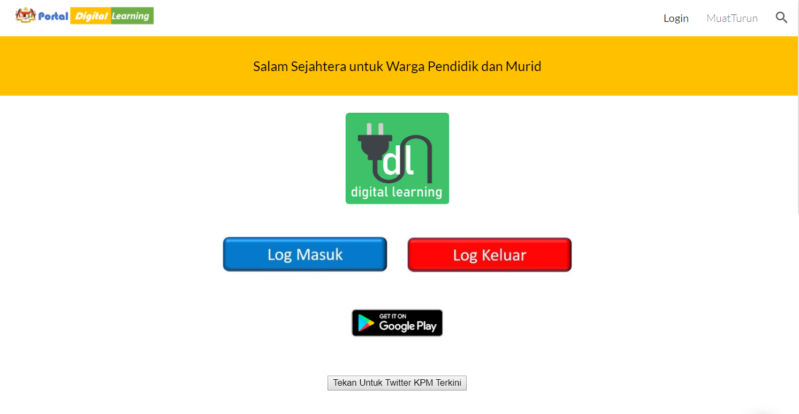
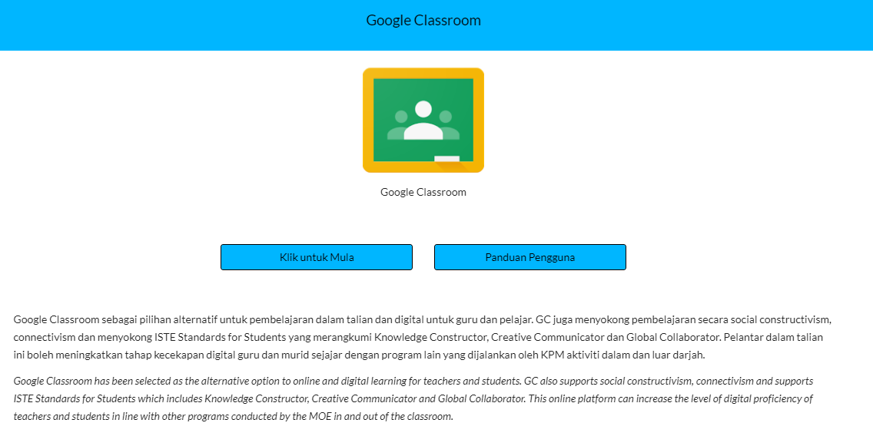
moe-dl.edu.my
Digital Learning Platform
MOE’s Digital Learning Platform
(Pelantar Pembelajaran Digital KPM)

Slide 5
DELIMa offers teachers and pupils all freely educational applications and services in one place.
What is DELIMa for?
01
Democratization of digital services – provide all options for teachers and pupils to learn online
02
Lifelong learning - the empowered student is the centre of it all
03
Digital Transformation – MOE committed to transforming education for the future needs of Malaysia
Created for: All Schools, teachers & pupils

Slide 6
Key Partners – One Platform = 3 Partners
Applications,
Services & Content
Teachers have access to all educational applications and services under one platform
One ID for all access for all
Integrated and seamless experience
Microsoft
Google
Apple

Slide 7
Digital Learning Pedagogy first focus
Digital teaching & learning ecosystem
More flexible – integration & diversity (standards driven)
Easier to communicate & share
Common understanding in creating, sharing and using digital content
The centred-student: empowering students to learn – lifelong learning.
Framework for digital learning
Teacher
Pupils
Technology
Content
Notes:
Q7 - missing now?
Q7-1/2
I just read and explain

Slide 8
A BETTER FUTURE FOR DIGITAL LEARNING
MOE DIGITAL CONTENT
PARTNERSHIPS - CONTENT
MOE CURATED AND GENERATED CONTENT FOR TEACHING & LEARNING
CONTENT FROM: GOOGLE, MICROSOFT, APPLE UNICEF, DIGI, MAXIS, CYBERSECURITY, INTEL
MOE APPLICATIONS & SERVICES
INTEGRATED
SPECIFIC SERVICES – BUKU TEKS DIGITAL (KPM)
ONE ID FOR ALL SERVICES – PERPUSTAKAAN NEGARA (BOOKS, JOURNAL ETC.
AT NO COST
BUILT BY MOE , FOR MOE
CERTIFICATION, BADGES & STANDARDS
DEVELOPED BY MOE’S DIGITAL LEARNING TEAM
CERTIFICATION FROM ALL PARTNERS (GOOGLE CERTIFIED TEACHERS)
SEAMLESS EXPERIENCE
SECURE & AVAILABLE WORLDWIDE
TEACHER & PUPILS EXPERIENCED CUSTOMISED
SECURITY AT CORE – THE ONLY CLOUD BASED PLATFORM – CGSO (JPM) APPROVED
PARTNERS

Slide 9
THANK YOU wshukry@moe.gov.my

Slide 10
Digitalisation of Education
- An ASEAN Perspective
3rd September 2020
Sum Lih Kang

Slide 11
Corporate Profile of Pelangi Publishing Group
PELANGI PUBLISHING GROUP is one of the leading educational publishers headquartered in Malaysia with its subsidiaries in Thailand, Indonesia, Singapore, UK and an associate company in China.
Dedicated to the betterment of quality education, PELANGI has an excellent track record in the design, publication, warehousing and distribution of books, educational comics, multimedia and digital products since 1979.
With over 40 years experience in publishing industry, PELANGI is now a full-fledged educational service provider, specialising in Editorial, Illustration, Printing and Distribution Services under one roof.

Slide 12
Key Observations of Digital Education
Basic infrastructure essential for schools and homes. Huge investment required.
e.g. Internet, Computers, Mobile Devices
1
2
Digital education helps students understand concepts better
e.g. 2D / 3D videos, animation, interactivity, augmented reality (AR), virtual reality (VR)
3
Blended learning (Physical + Digital Elements) most practical now.
Online classes more effective for tertiary education. K-12 classes requires supervision
4
Teachers need to be well trained for online teaching as well digital skills
5
More educational contents being converted or produced in digital format
6
More studies needed for pedagogies of teaching digital concepts in non-digital ways
e.g. Computational thinking, Unplugged coding

Slide 13
THE LIMKOKWING FILM ACADEMY
TARGET GROUPS
INDUSTRY PRACTITIONERS
GUILD MEMBERS
MEMBERS FROM DIFFERENTLY-ABLED & MINORITY COMMUNITIES
PUBLIC SECTOR OFFICIALS
PROGRAMS DEVELOPMENT
JOINTLY DEVELOPED & DESIGNED BY
LIMKOKWING UNIVERSITY ACADEMIA AND
ASSOCIATIONS/GUILD

Slide 14
THE LIMKOKWING FILM ACADEMY
PROGRAM DEVELOPMENT & DESIGN
BASED ON ECOSYSTEM VALUE CHAIN
Ideation
&
Setting up
Production
Post
Production
Outputs
Marketing
& Commercial
Exploitation
Pre
Production
Production
Scripting
Make Up & Hair Design
Costume & Accessories Design
Set Design
Production Design
Sound Design
Locations
Licenses & Permits
Directing
Performing
Cinematography
Lighting
Sound
Make-Up & Hair Design Accounting
Editing
VFX
Sound EFX
ADR
Music Scoring
Subtitling
Dubbing
Colour Grading
Subtitling
Dubbing
Poster Design
Trailers
A&P
Distribution
Sales
Negotiation Skills
Copyrights
Licensing &
Merchandising
Festival Placements
Transmedia Planning
Financing
Producing Entrepreneurship
Sales Agent
Logline,Synopsis & Pitching
Budgeting
Project Timeline

Slide 15
THE LIMKOKWING FILM ACADEMY
THE CERTIFICATED SHORT PROGRAMS ON OFFER
(BEGINNERS, INTERMEDIATE & ADVANCED/MC)
Ideation
&
Setting up
Production
Outputs
Marketing
& Commercial
Exploitation
Pre
Production
Production
Post
Production
Screenplay for Film & TV
A-Z of Film-Making
Directing for Film & TV
Editing
Licensing & Merchandising
Screen Adaptations
Budgeting for Film & TV
Make Up & Hair Design
Cinematography
VFX
A&P
Producing For Film & TV
Wardrobe & Costume Design
Acting for Film & TV
Sound EFX/Foley
On-Set Make Up & Hair
Music Scoring
Production Staging (Set Design)
Sound Design
Production Accounting

Slide 16
THE LIMKOKWING FILM ACADEMY
CERTIFICATES
CERTIFICATES OF ATTENDANCE WILL
BE JOINTLY ISSUED BY
THE LIMKOKWING FILM ACADEMY & THE ASSOCIATIONS/GUILDS

Slide 17
THE LIMKOKWING FILM ACADEMY:
TRANSITING FROM SHORT PROGRAMS
TO ACCREDITATION & ACADEMIC PROGRAMS
Minimum Rates
Matrix agreed between
Craftsmen Guilds,
Producers And
Broadcasters based on
Accreditation Tiers
UPSKILL
UPGRADE
(INTERMEDIATE & ADVANCED)
CERTIFIED
SHORT
PROGRAMS
1
ACCREDITATION
BY INDUSTRY
1
Experienced
ABOVE LINE CREW
BELOW LINE CREW
CAST
2
ACADEMIC
PROGRAMS
@ LIMKOKWING
UNIVERSITY
3
4
New Entrants
Incl School
Leavers
5
BEGINNERS
CERTIFIED SHORT PROGRAMS
INTERNSHIPS
6

Slide 18
THE LIMKOKWING FILM ACADEMY:
TRANSITING FROM SHORT PROGRAMS
TO ACCREDITATION & ACADEMIC PROGRAMS
ACCREDITATION
BY INDUSTRY
1
EMPLOYMENT AND PLACEMENTS
2
ACADEMIC
PROGRAMS
@ LIMKOKWING
UNIVERSITY
3
4
5
6

