Slide 1
Webinar PBEC RTT MVA – Question No 4 – MVA and business on the Moon
MVA Lunar Commerce and Economics WG develops the Lunar Commerce Portfolio (Chris slide 1/3)

Slide 2
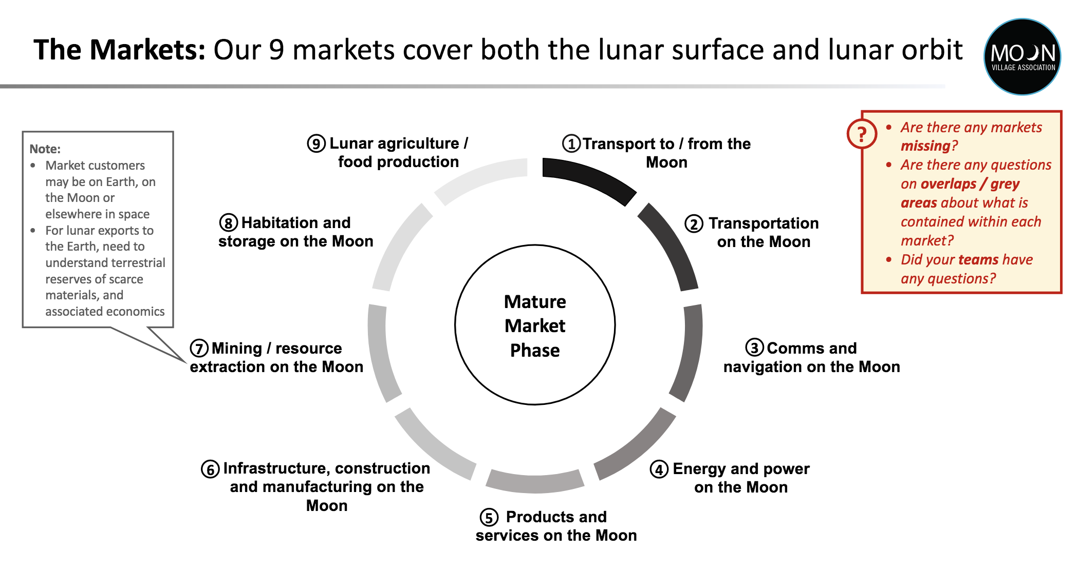
Webinar PBEC RTT MVA – Question No 4 – MVA and business on the Moon
MVA Lunar Commerce and Economics WG develops the Lunar Commerce Portfolio (Chris slide 2/3)

Slide 3
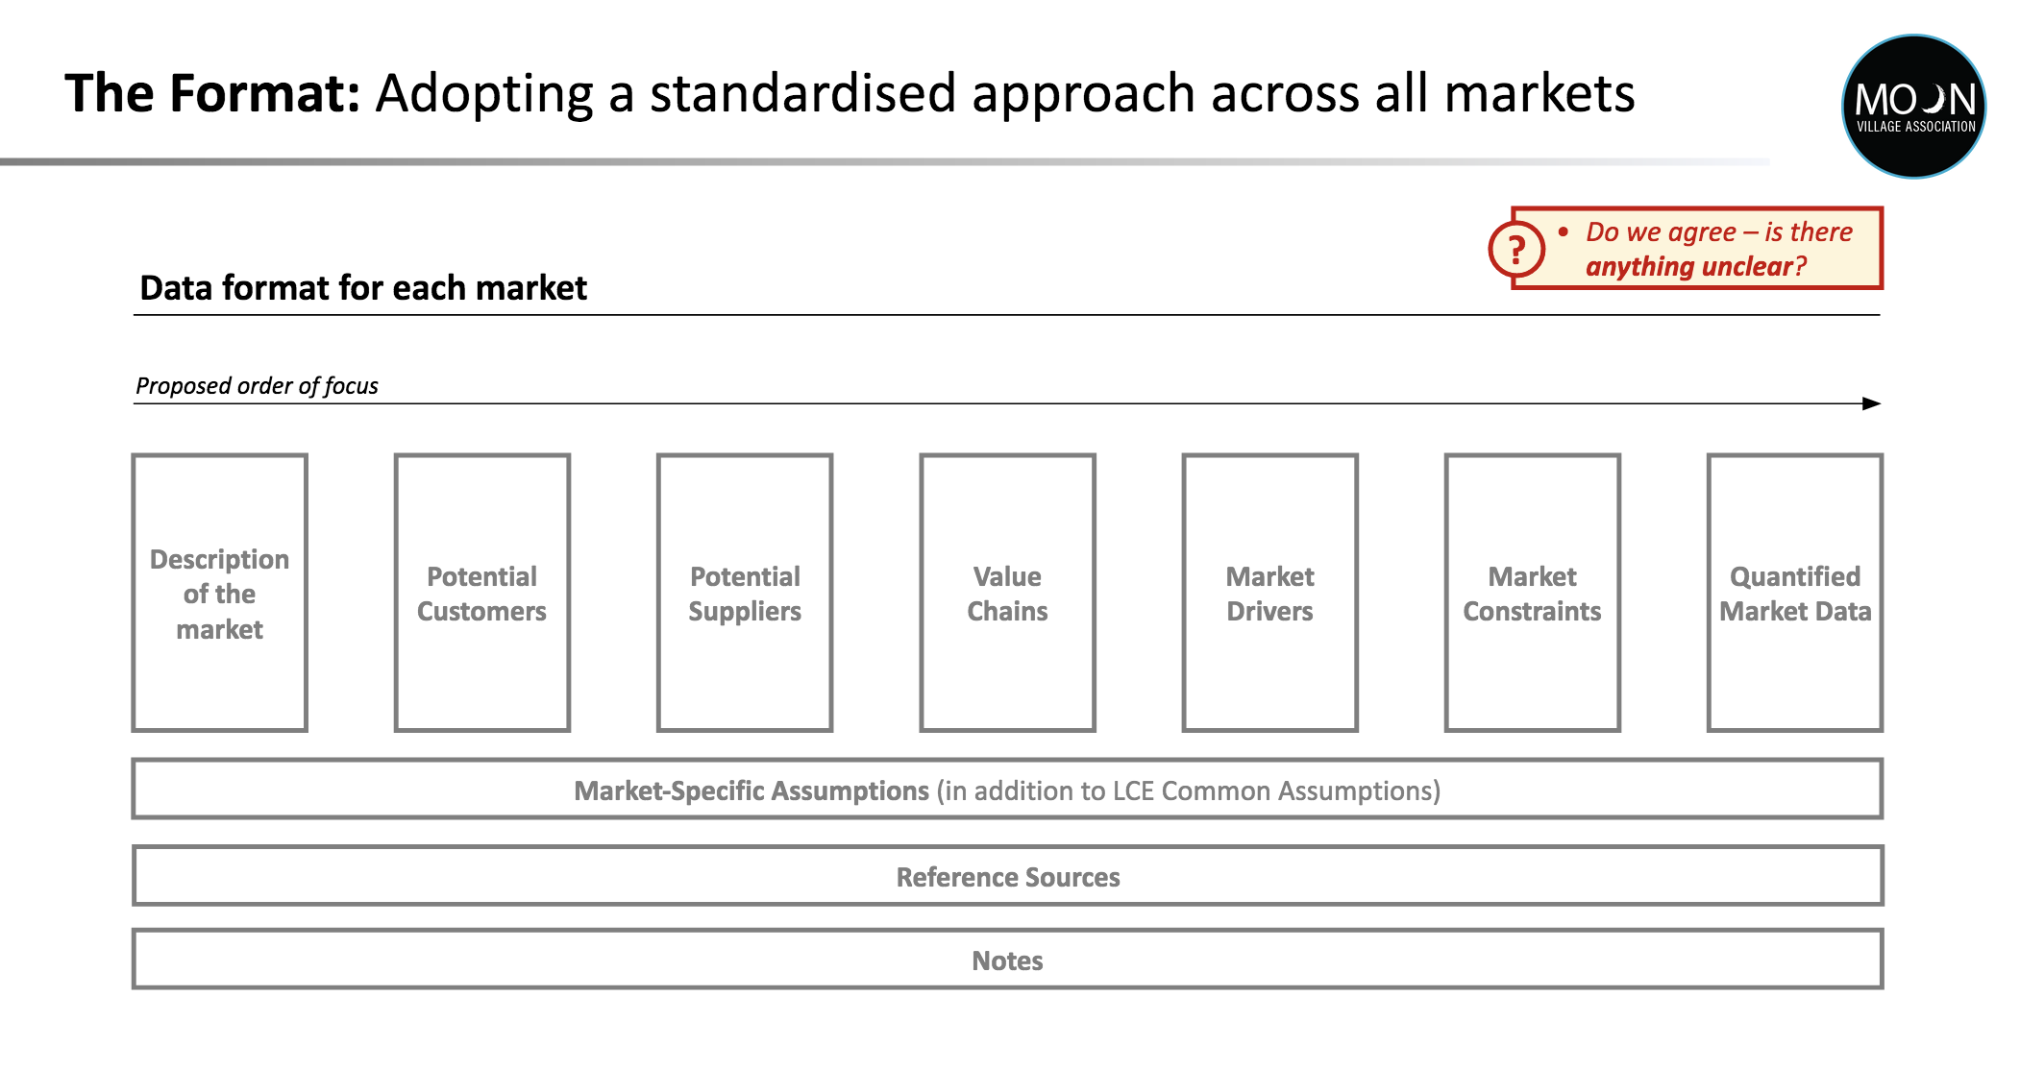
Webinar PBEC RTT MVA – Question No 4 – MVA and business on the Moon
MVA Lunar Commerce and Economics WG develops the Lunar Commerce Portfolio (Chris slide 3/3)

Slide 4
Webinar PBEC RTT MVA – Question No 5 – Space/M.: preventing war, benefiting humankind
Space & Moon business impact on science & economy to benefit society and humankind (Chris slide 1/1)
Space impact today: Earth observation, climate, water, agriculture, sea, infrastructure
Space impact in next 5-10 years: mega-constellations, data economy, new business models, fintech, insurance,…
Space/Moon impact in next 10-20 years and beyond:
- better understanding of human individual and collective resilience in a tough environment
- development & production of pharmaceutical molecules in micro-gravity
- development & production of advanced materials in micro-gravity
- advanced water and waste treatment tech, circular recycling economy
- advanced organic agricultures and food production tech
- space based solar power
- navigation, comms, and mapping, remote sensing
- robotics, autonomous transportation and systems
- Moon mining & resource utilization, in situ and in orbit
- manufacturing high value components with Moon metals and rare earth elements for Earth & space markets
- advancing fintech and legal tech for developing a material and digital economy on Earth and in space (data)

Slide 5
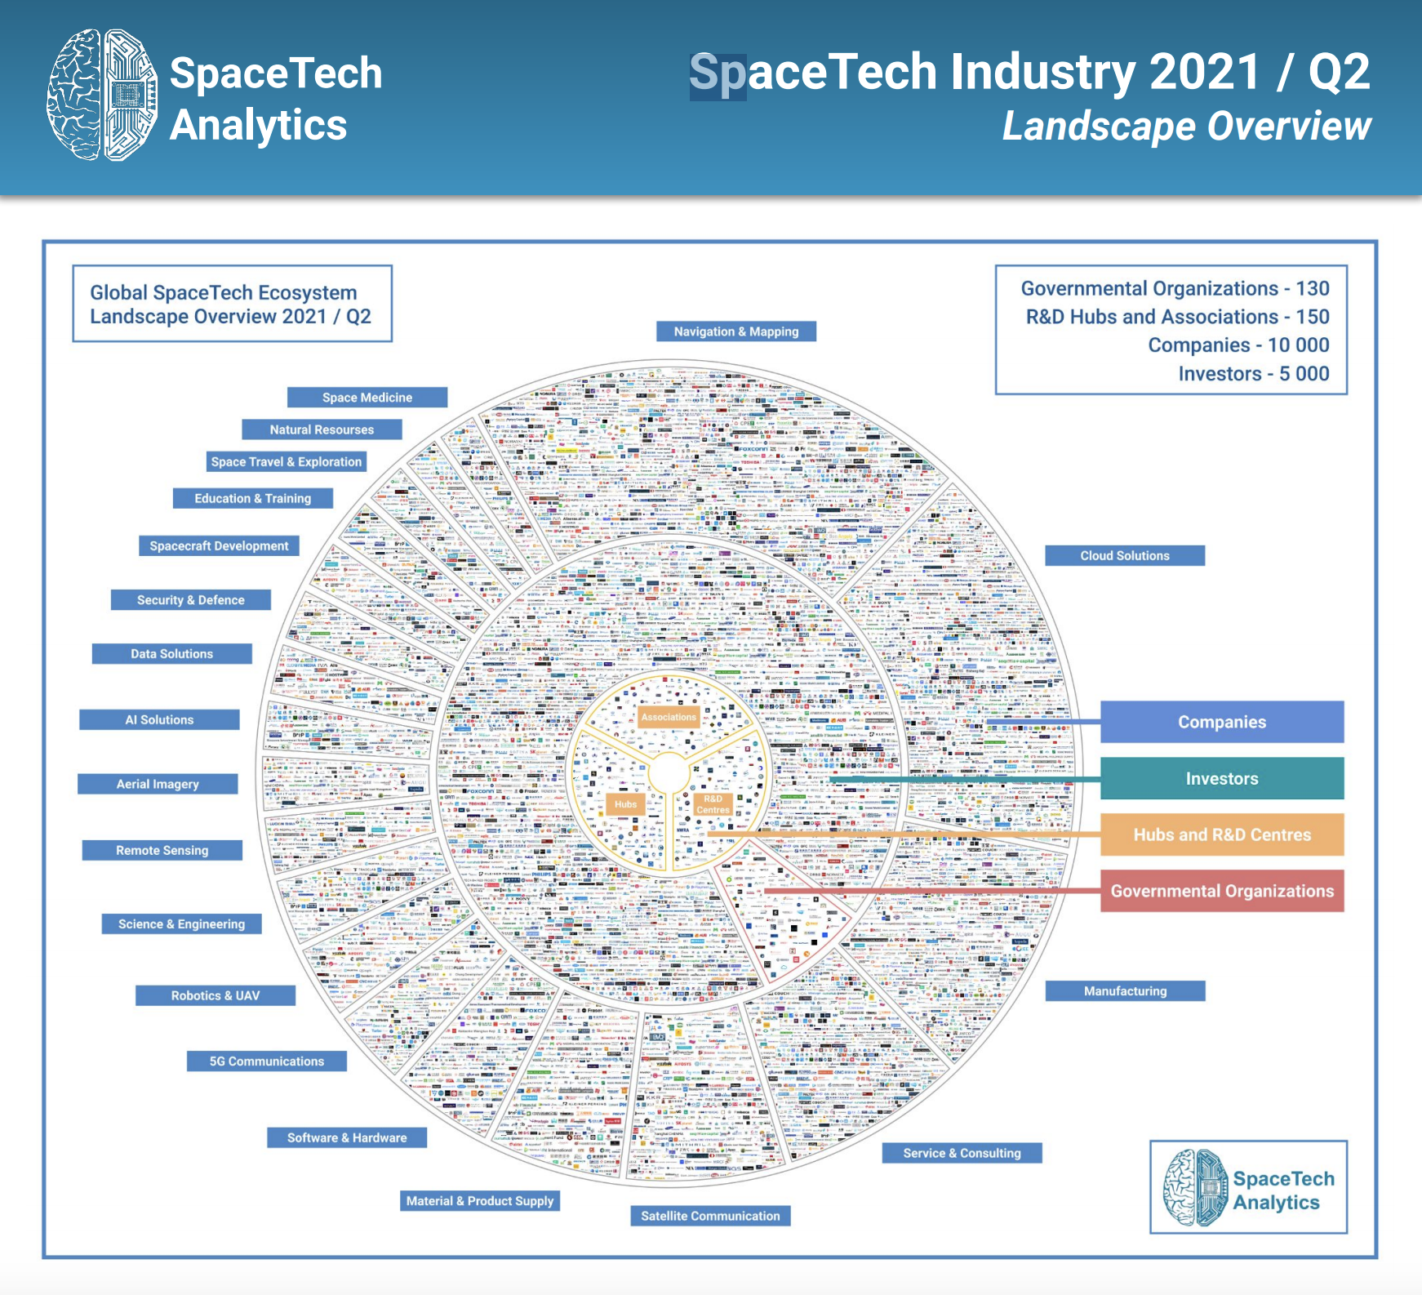
Webinar PBEC RTT MVA – Question No 6 – Perspectives for space/Moon business in Asia-Pac
Developing a space ecosystem in and beyond orbit especially in ASEAN with int’l cooperation (Chris slide 1/1)

