Slide 1
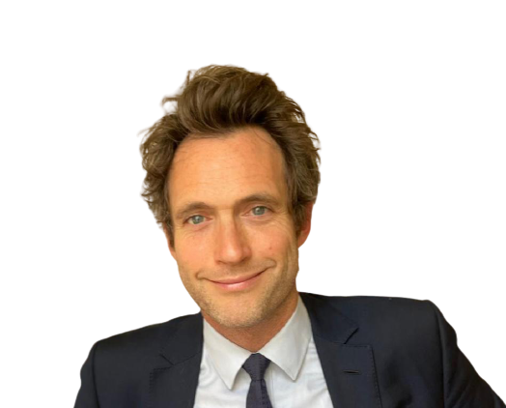
Space Technology and the Commercialisation
of Low Earth Orbit
Edward Hobbs
Senior Partner
Jose Salgado
President

Slide 2
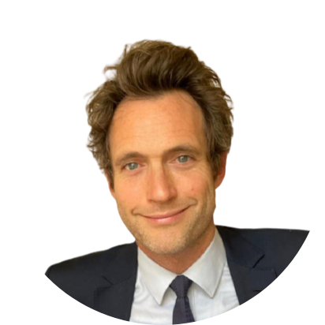
Edward Hobbs
Senior Partner
With Over 20 years of experience in the Aerospace Sector. Edward was the Director of Hawk Associates, a British registered, open source intelligence and strategy specialist offering support to organisations within the global Aerospace, Defence, Security and Financial sectors. The company is dedicated to providing ongoing information-led services including market analysis, technology and risk intelligence, real-time data analytics, strategic consultancy and training.

Slide 3
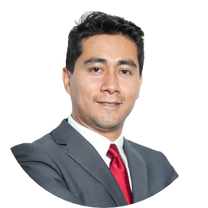
Jose Salgado
President
Space Columnist at Business Insider Mexico and Cosmo magazine, the only European publication specialized in Space Economy. Founder and former President at the Canadian Chamber in Italy, Jose is the current point of reference for the space sector between these two ecosystems. Advisor to the Italian Interparliamentary group for Space. With an accounting and financial background, Jose is currently an expert on the commercialization of space-based assets.

