Slide 1
Federico G. Lepe
WTC -Guadalajara

Slide 2
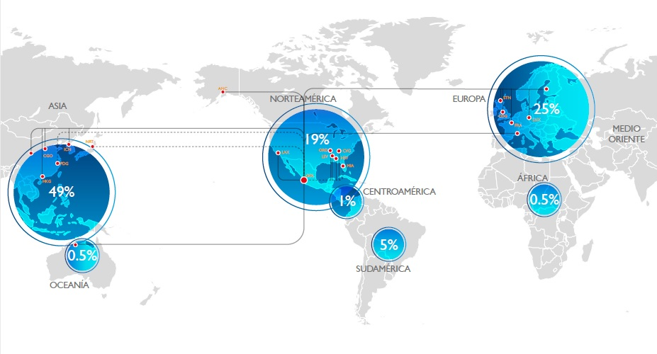
GDL WW CARGO TRADE

Slide 3
GDL TOTAL CARGO TRADE
YEAR | 2019 | 2020 | 2021 | 2022
GRAN TOTAL | 148,400 TONS | 153,000 TONS | 185.000 TONS | 135,000TONS
 |  | EST.- Y.E. 2022 |  | 173,000 TONS
Notes:
3
3

Slide 4
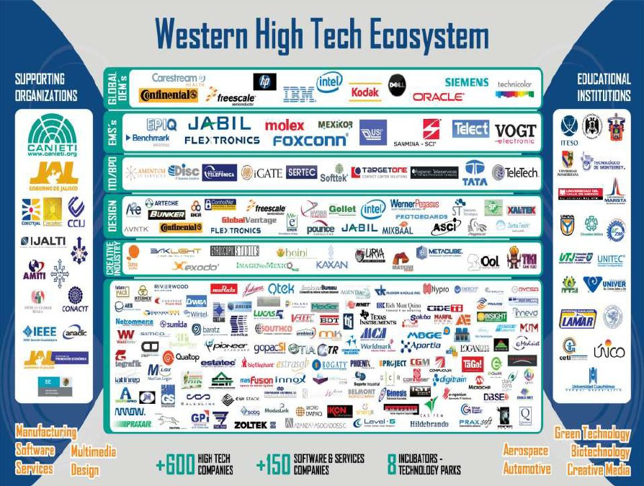

Slide 6
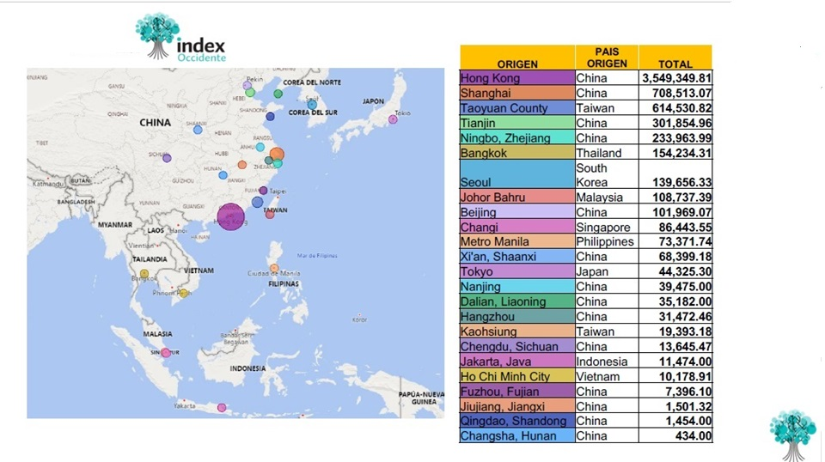
HIGH TECH ASIA IMPORT/VOLUME
SOI: Index Occidente

Slide 7
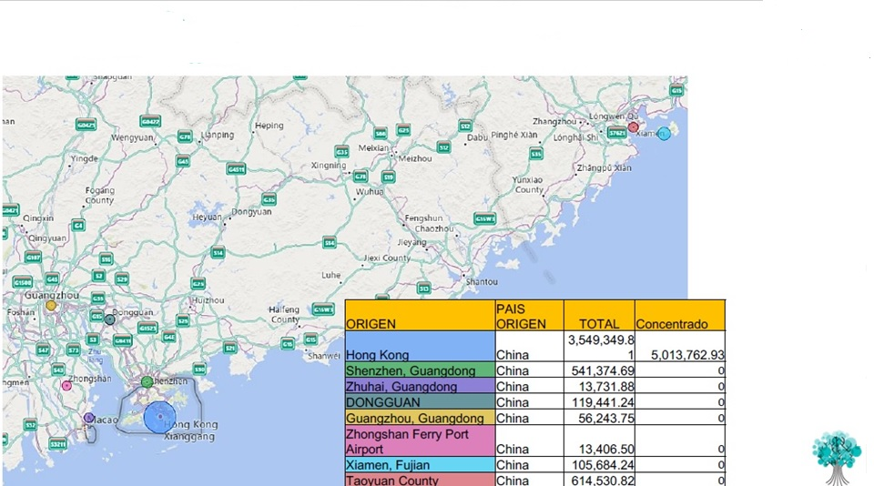
HONG KONG CONSOLIDATION
SOI: Index Occidente

Slide 8
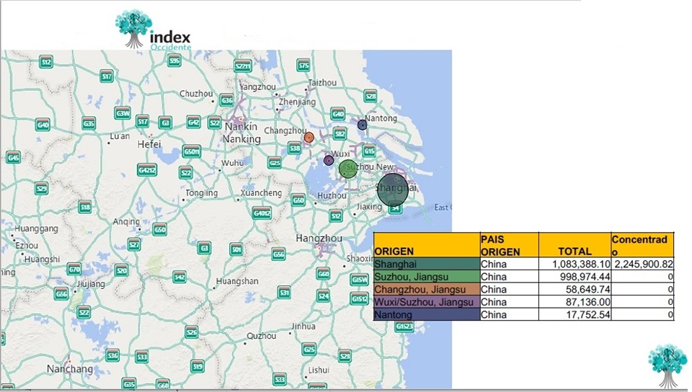
SHANGHAI CONSOLIDATION
SOI: Index Occidente

Slide 9
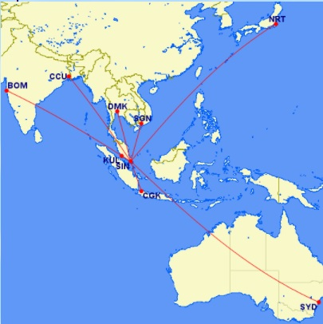
SINGAPORE SWITCHING CENTER
Singapore 86,443
Bangkok 154,234
Malaysia 108,737
Manila 73,371
Jakarta 11,474
Ho Chi Min 10,179
Tokyo 44,325

Slide 10
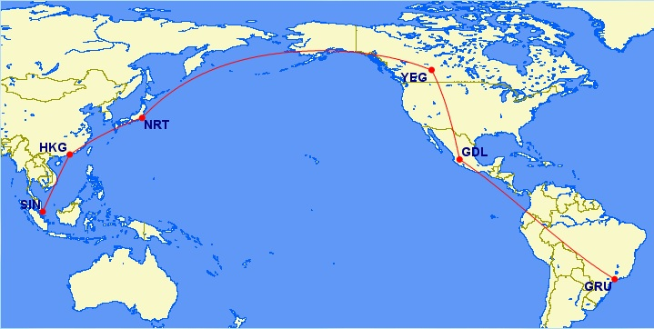
SINGAPORE – LAR DIRECT LINK

Slide 11
SIN

Slide 12
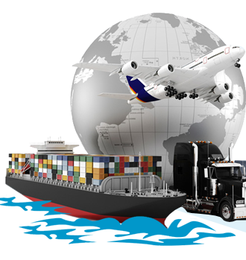
Let's work together to create a better world

Slide 13
HIGH TECH 2023 INVESTMENTS
FOXCOMM $ 150 M. USD
SANMINA $ 216 M. USD
JABIL $ 400 M. USD
FLEX $ 100 M. USD
SOLAREVER $1,100 M. USD
WTECH $ 201 M. USD
SAVERGLASS $ 116 M. USD

