Slide 1
Managing Uncertainty: Sustainable Economic Growth in the Age of Complexity
PBEC 55th Annual Dialogues Summit 2022

Slide 2
Annabella Matute – Castro Lawyer in Commercial and Construction law UK- Latin America
M C Services Links
www.mcserviceslinks.co.uk
info@mcserviceslinks.co.uk

Slide 3
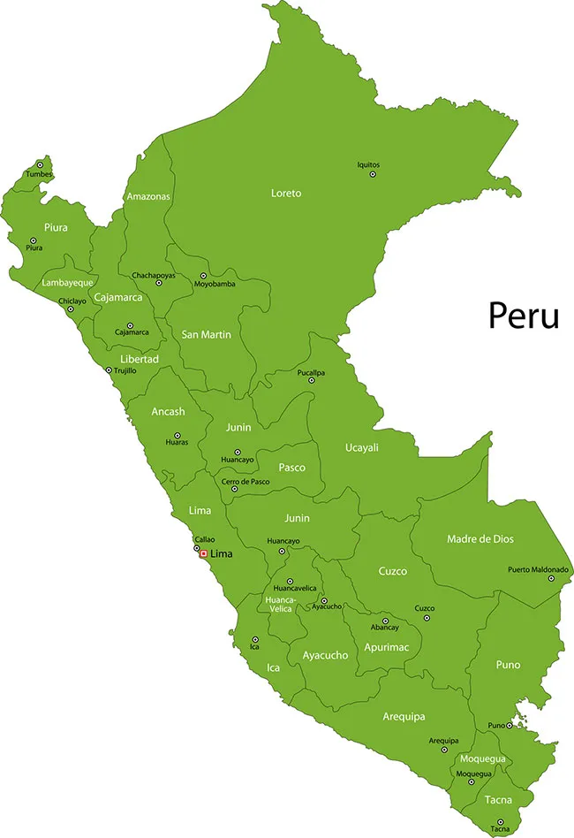
Peru trade and investments

Slide 4
Government to Government Agreements (G2G)
Public Infrastructure sector works: reform on infrastructure sector
Introduction of BIM and collaborative contracts: NEC, FIDIC and DB
Support in procurement
Funding opportunities

Slide 5
G2G with UK: Bicentennial schools (75)
G2G with France: Health projects (hospitals)
G2G: with France (Deviandes): Central Road
G2G: South Korea: Chinceros airport in Cuzco

Slide 6
Comprehensive and Progressive Agreement for Trans-Pacific Partnership (CPTPP)
Members:
Oceania:
Australia, New Zealand
Asia:
Brunei, Japan, Malaysia, Singapore, Vietnam
America:
Canada, Chile, Mexico, Peru.

Slide 7
Applicants
China
Costa Rica
Ecuador
Taiwan
UK requested accession in 2021

